Slide 1
MyDMV Alexa Skill
NYS Department of Motor Vehicles

Slide 2
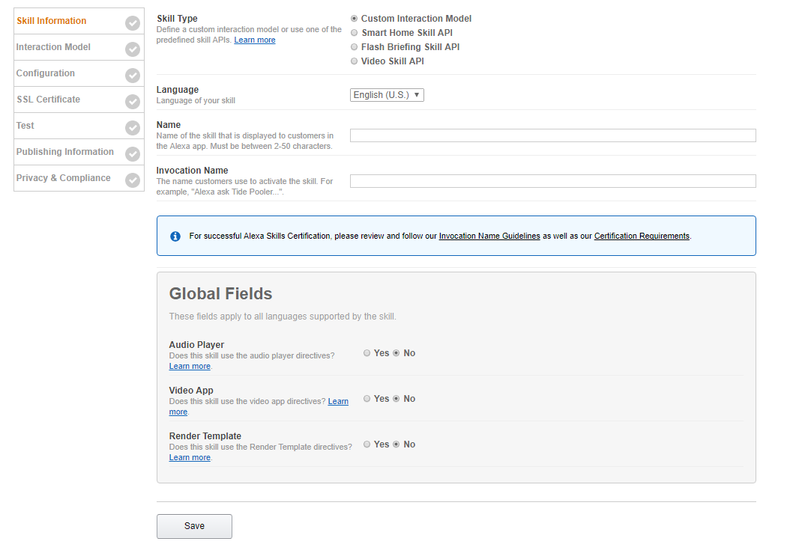
Step 1 – Voice User Interface (VOI)
The first of two parts that make up an Alexa Skill.
This is where you:
Define how the skill handles a user’s voice input
Which code should be executed when specific commands are uttered
VOI Steps:
Step 1: Skill Information
Step 2: Interaction Model
Step 3: Configuration
Create A New Skill In The Developer Console:

Slide 3
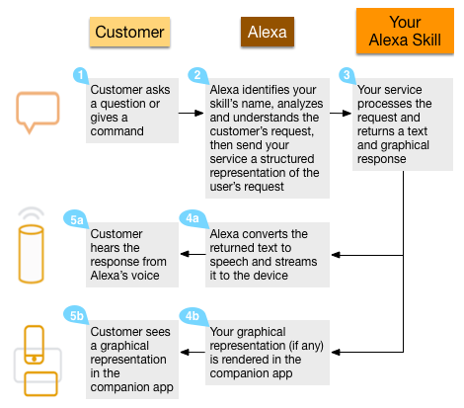
Skill Information – Skill Type
Custom Skills:
Allow for the most control over the user’s experience. For a custom skill, you (as the developer) define the request the skill can handle. These are defined as intents.
Smart Home Skills:
For building a skill to control smart home devices such as lights and thermostats, consider using the Smart Home Skill API. This gives you less control over the user’s experience, but simplifies development since you do not need to create the voice user interface yourself. These skills are also easier for end users to invoke, since they do not need to remember any invocation name and can make requests such as “Alexa, turn on the living room lights.”
Flash Briefing Skills:
A flash briefing skill is the only way that you can provide content for a customer’s flash briefing.
Video Skills:
A video skill enables you to provide video content such as TV shows and movies for customers.
User Interaction Flow For A Custom Skill:

Slide 4
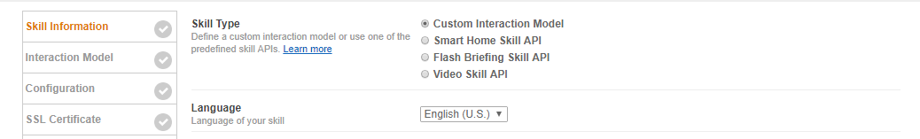
Skill Information – Languages
Developing Skills in Multiple Languages:
Users who interact with Alexa in a particular language can use skills that support that language. For example, a user might set their Alexa device to use German. That user can enable and use any published skills available in their region that support German.
You can use the Alexa Skills Kit to create skills in multiple languages. A skill can support a single language, or any combination of the available languages:
English (US)
English (UK)
German
Select the language you wish to develop for from the dropdown box.
NOTE: You can add support for multiple languages when you’re defining the Interaction Model.

Slide 5
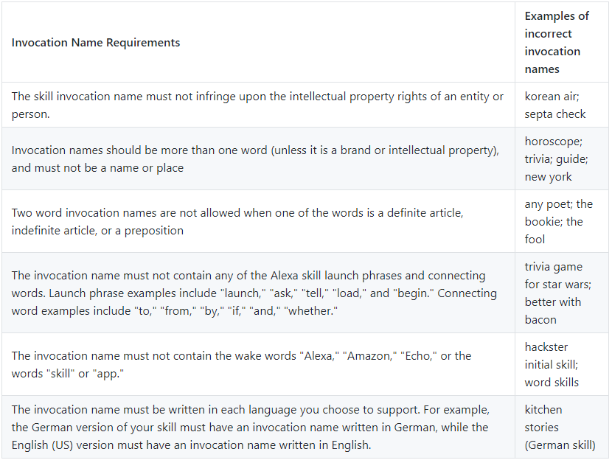
Skill Information – Name & Invocation Name
Common Mistakes:
Name:
This is the name that will be shown in the Alexa Skills Store, and the name users will refer to.
Invocation Name:
This is the name that users will need to say to start the skill. Requirements for the Invocation Name are as follows:
No numeric, special characters, or punctuation. Note that possessive apostrophes & periods used in abbreviations are allowed
Does not contain “Alexa”, “Echo”, or “Amazon”
Should be between 2-50 characters
Is recommended that the Invocation Name be shorter than or equal to 3 words
Common mistakes developers make when creating an Invocation Name are displayed in the figure to the right

Slide 6
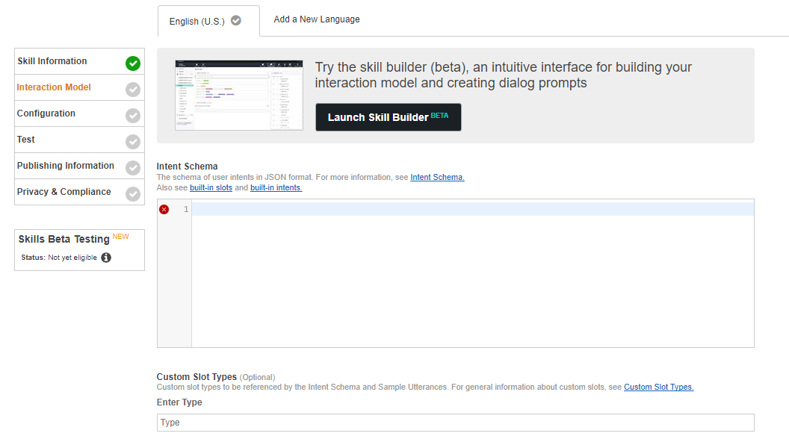
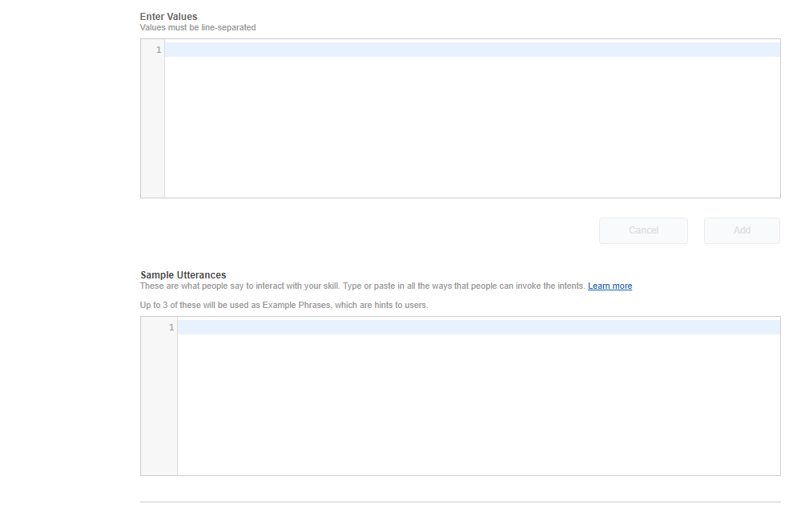
Interaction Model
To define the voice interface, you map users’ spoken input to the intents your cloud-based service can handle.
Intents: An intent represents an action that fulfills a user’s spoken request. Intents can optionally have arguments called slots. Intents are specified in a JSON structure called the Intent Schema.
Custom Slot Types: A representative list of possible values for a slot. Custom Slot Types are used for lists of items that are not covered by one of Amazon’s build-in slot types.
Sample Utterances: A set of likely spoken phrases mapped to the intents. This should include as many representative phrases as possible.

Slide 7
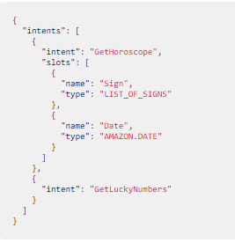
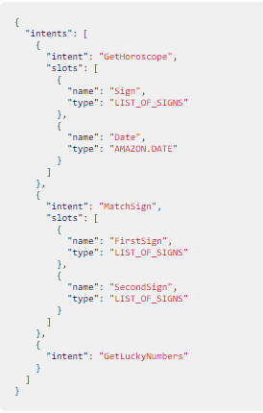
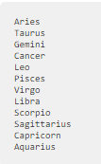
Interaction Model – Intent Schema
An intent represents an action that fulfills a user’s spoken request. Intents can optionally have arguments called slots. For example, the intent schema for “Daily Horoscopes” might define an intent named “GetHoroscope” that has slots named “Sign” and “Date”. A user can then say:
User: Alexa, ask Daily Horoscopes for the horoscope for Pisces today.
The Alexa service sends the Daily Horoscopes service a “GetHoroscope” intent with the value of “pisces” in the “Sign” slot and the current date in the “Date” slot. The service can then look up today’s horoscope for Pisces and send back the text to convert to speech.
The intents are defined in a JSON structure called an intent schema. An example intent schema of the Daily Horoscopes skill is picture right.
Slots are defined with different types. For instance, the Sign slot in the above example is defined as a custom type LIST_OF_SIGNS to reference a list of horoscope sign values provided for the slot (Aries, Capricorn, etc.). The Date slot uses Amazon’s built-in AMAZON.DATE type to convert words that indicate dates (such as “today”) a date format.
Intent Schema (Built-In Slots):
Intent Schema (Custom Slots):
Custom Slots:
Note that the Alexa Skills Kit provides a library of built-in intents for common actions. If you want to implement these, you include them in your intent schema just like your own custom intents. For details, see Implementing the Built-in Intents.
A custom slot type defines a list of representative values for the slot. Custom slot types are used for lists of items that are not covered by Amazon’s built-in set of types and are recommended for most use cases. When using a custom type, you define the type and its values, and specify the name of the type as part of the intent definition.

Slide 8
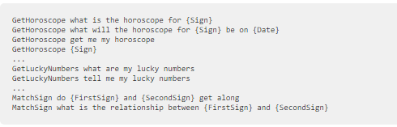

Interaction Model – Sample Utterances
Sample Utterances:
Each possible sample utterance is assigned to one of the defined intents. For example, the following snippet from a sample utterances file maps four possible phrases to the GetHoroscope intent, two phrases to the “GetLuckyNumbers” intent, and two phrases to the “MatchSign” intent.
Sample Utterance Syntax:
Each line of a sample utterance files consists of two fields separated by tabs or spaces:
The name of the intent on the left
The phrase a user might speak to signal that intent on the right
Slots mapped to intents are represented in the right side of a line by writing the name of the slot in curly braces: {SlotName}

